Slide 1
Life in the day of me
Chloe Jiang
cfjiang

Slide 2
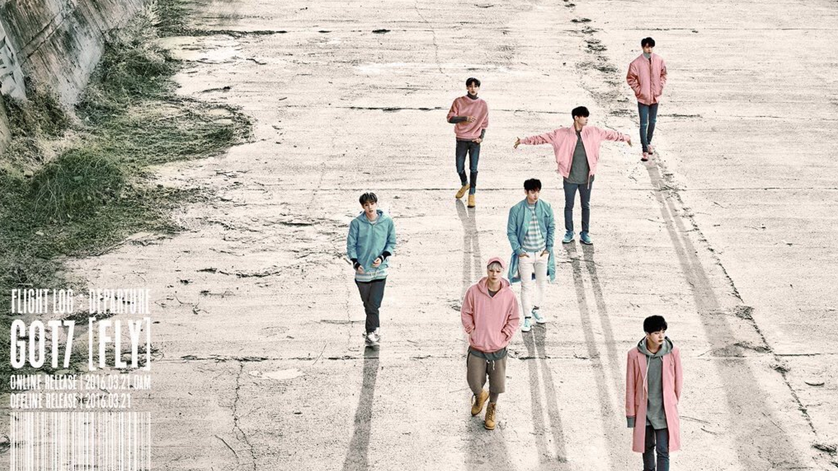
This is a Korean boyband called GOT7

Slide 3

Here is a music video of them!

Slide 4
Here is a chart of color preferences by grade. Overall red is popular with freshmen and seniors, while blue is for sophomores and juniors.

Slide 5
Hobbies that I like to do
Eat
Sleep
Dance
Hip hop and cover dances
I’m not very good at it but I try
I just learned how to use shift + tab

